Slide 1

Woman with their socializing instincts try their best when it comes to making connections and bond together.
Due to this pandemic we all have become distant from each other.
Our team strongly believes that we all need a solution to bridge this gap, get inspired to bring life on track, share /solve each others problems and struggles
GangUp
Team Thenos

Slide 2
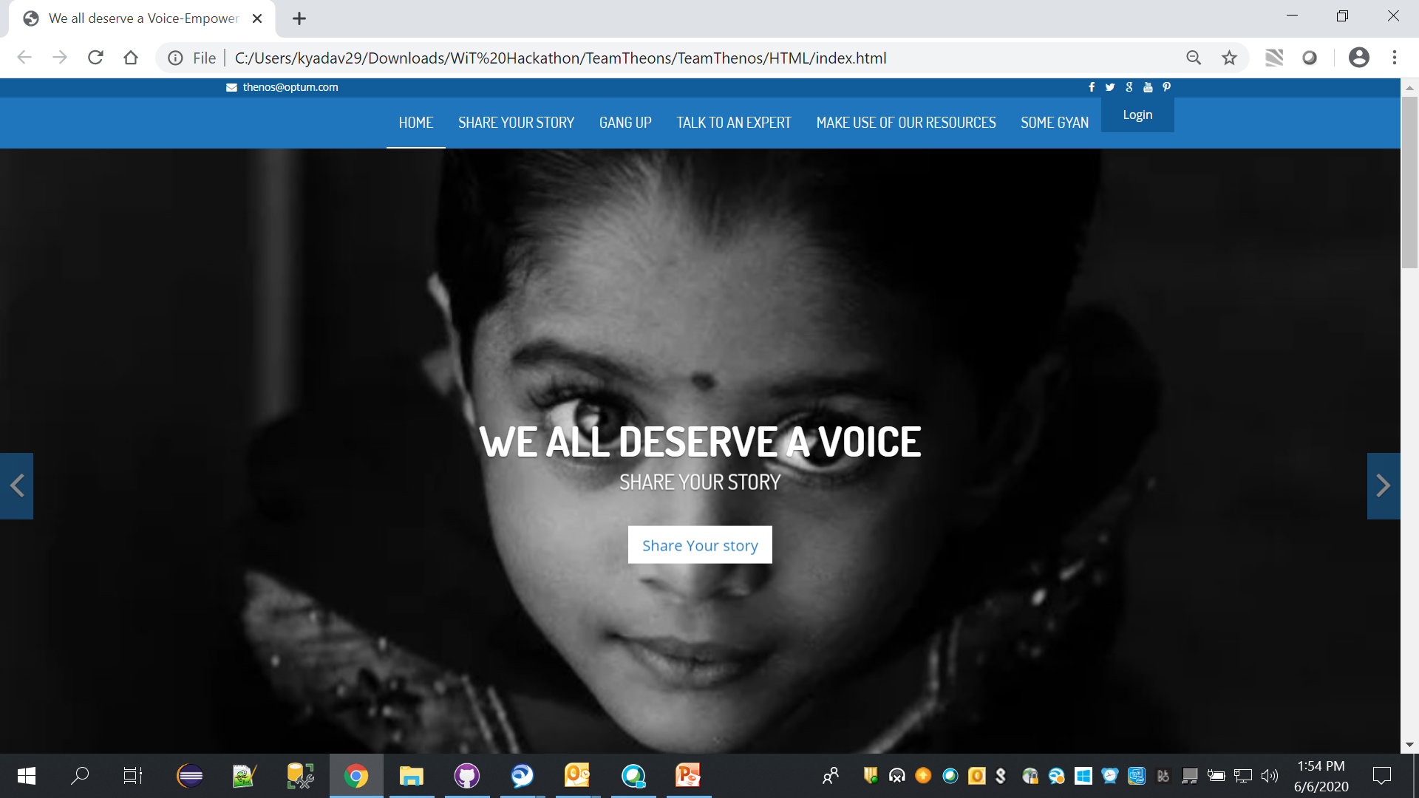
GangUp in this Pandemic times
To share your stories
Get Inspired by others
Meet, connect and learn virtually
Seek advice from experts
Stay Updated with all the women centric information

Slide 3
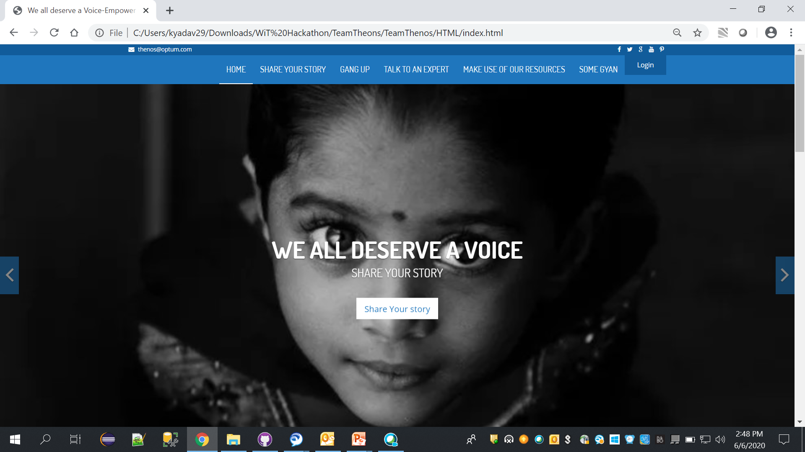
Join Us
Join Us with your email

Slide 4
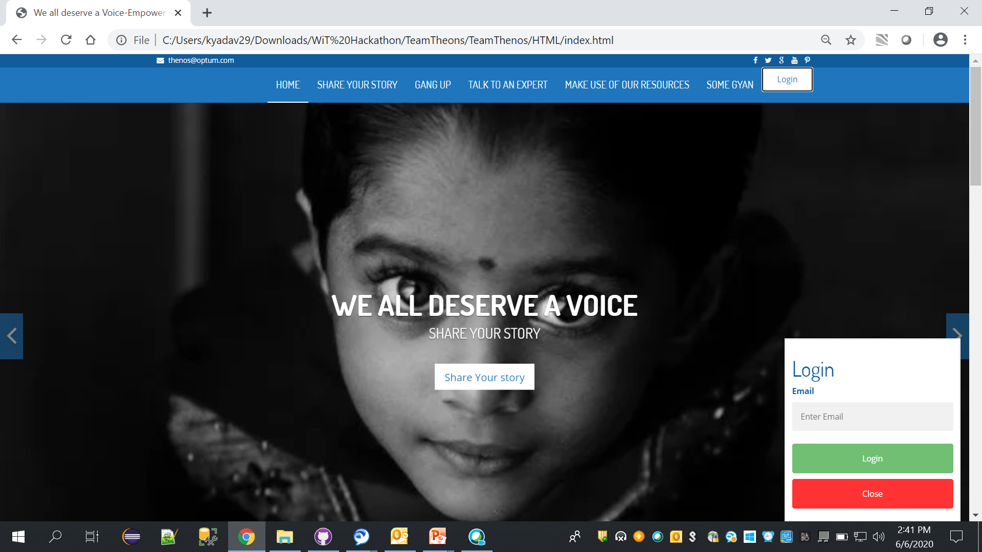
Join Us
Join Us with your email

Slide 5
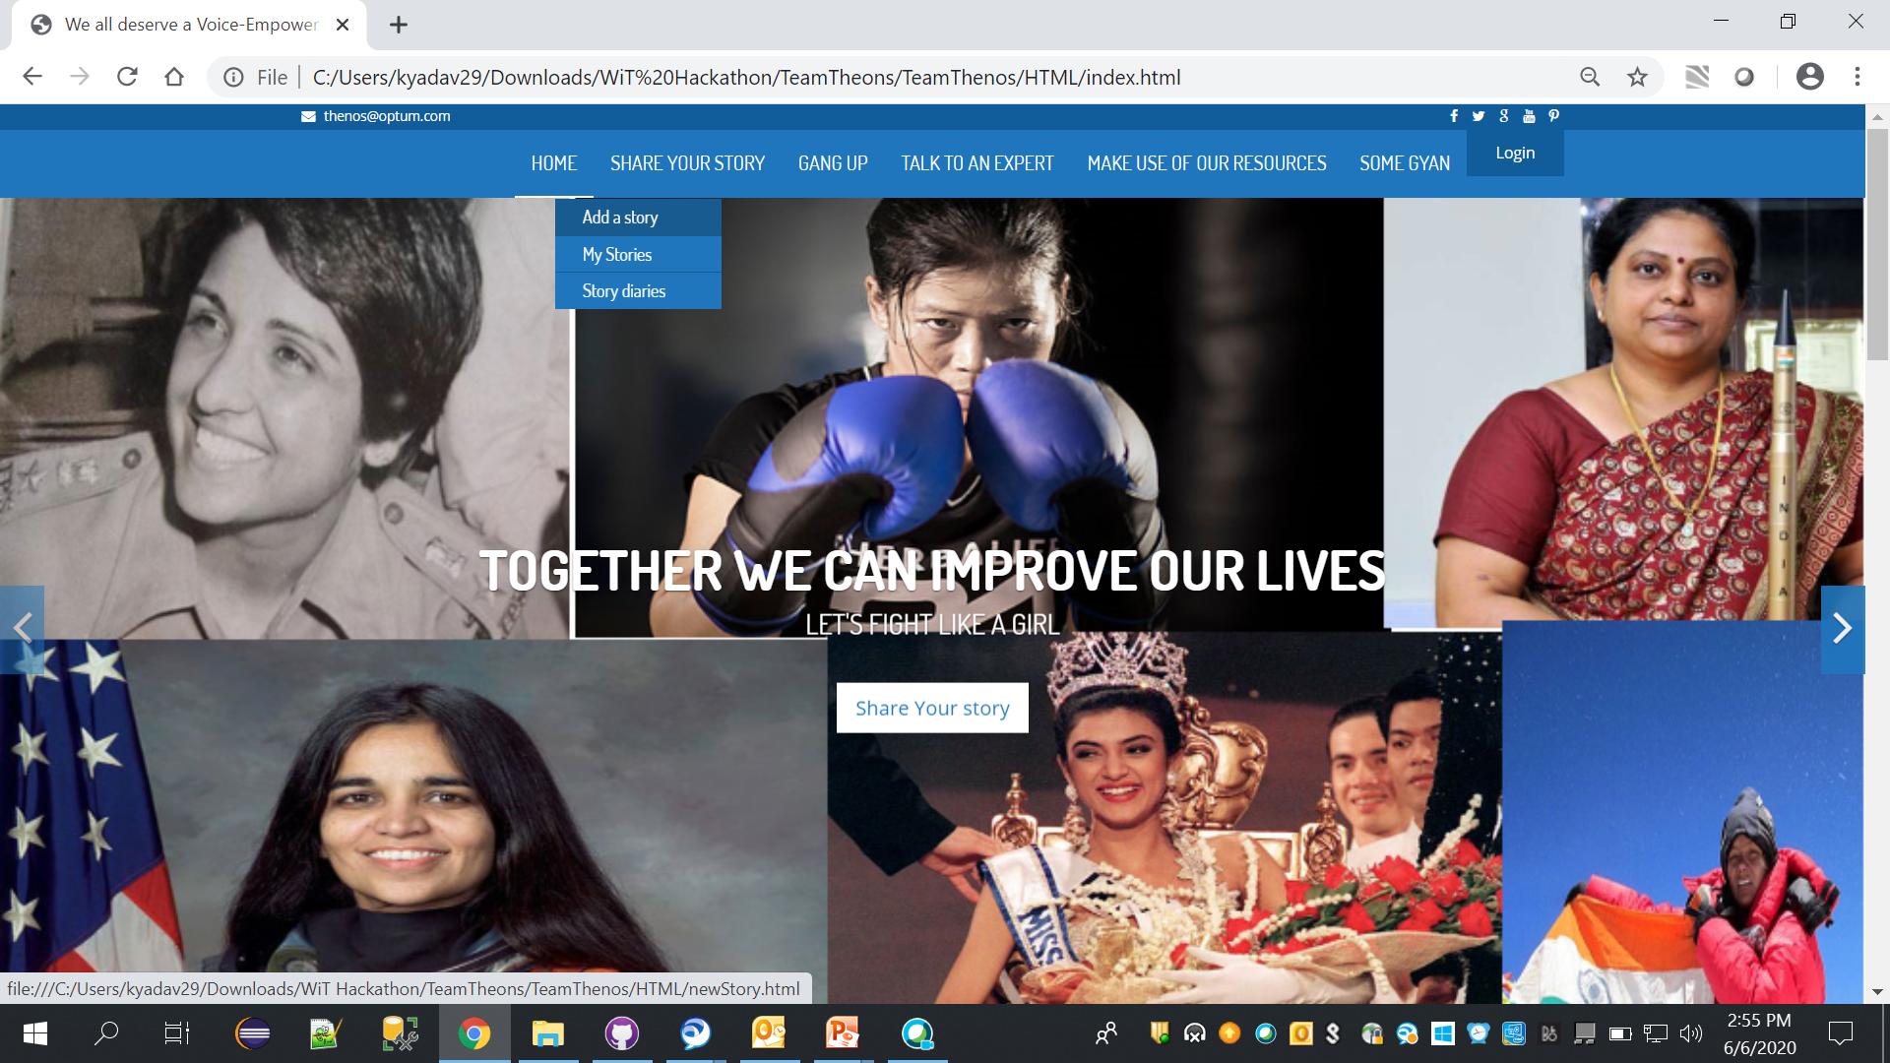
SHARE YOUR STORY

Slide 6
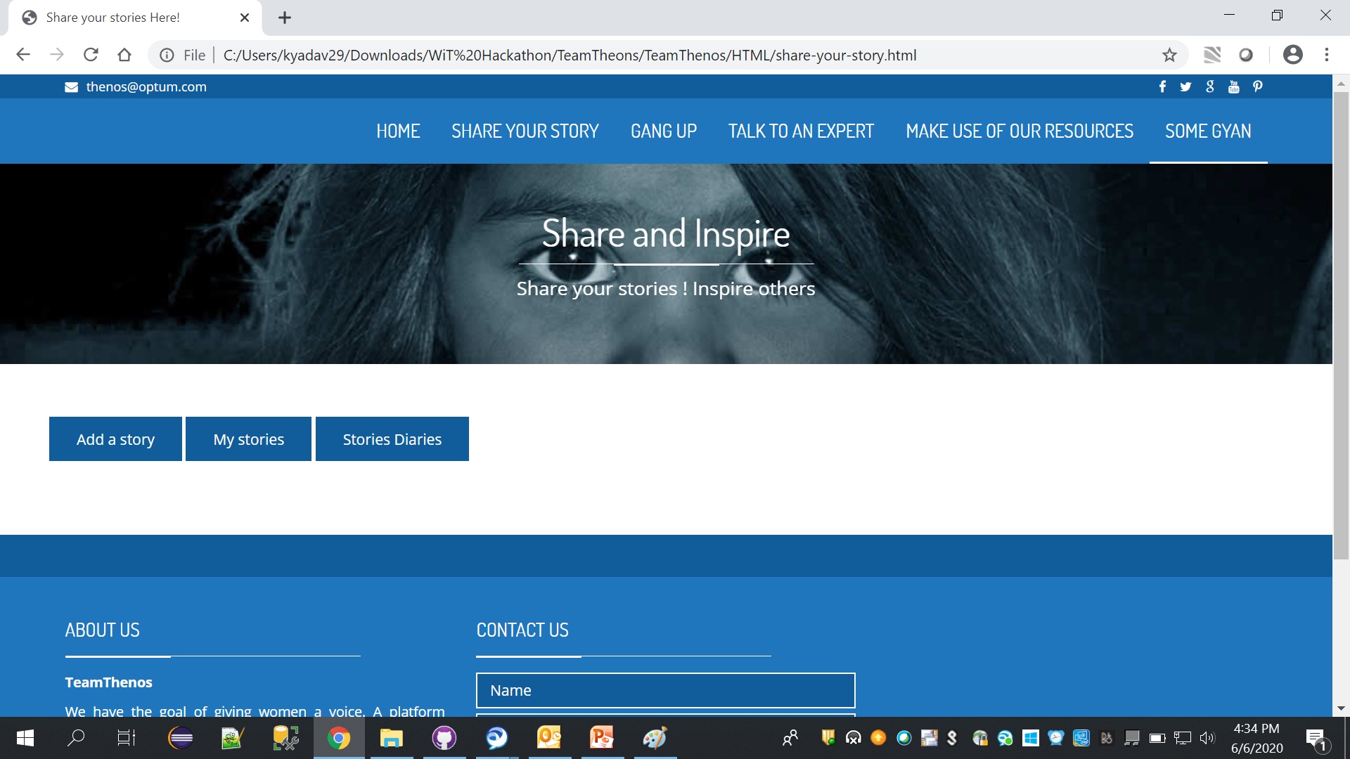
SHARE YOUR STORY
Share your experience of dealing pandemic situation.
Like it
Comment it
Help others know better about it

Slide 7
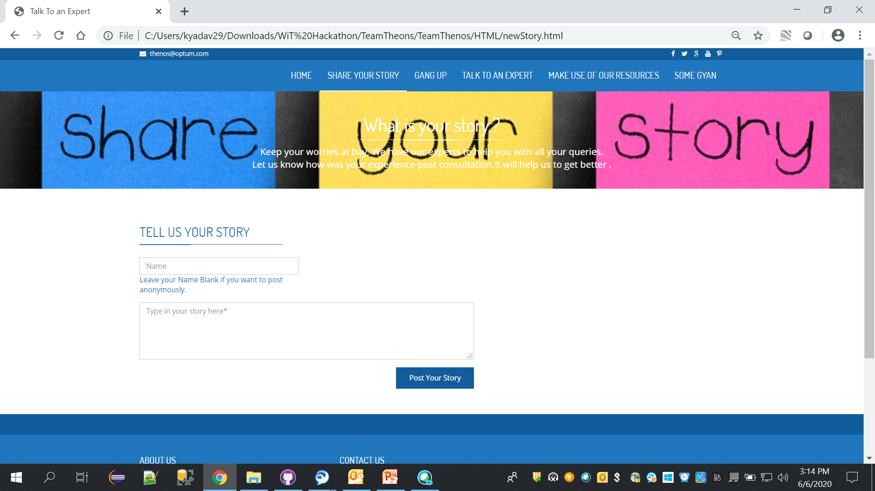
AddStory
ADD A STORY
Give your name or post anonymously
Write your story here
& Post it

Slide 8
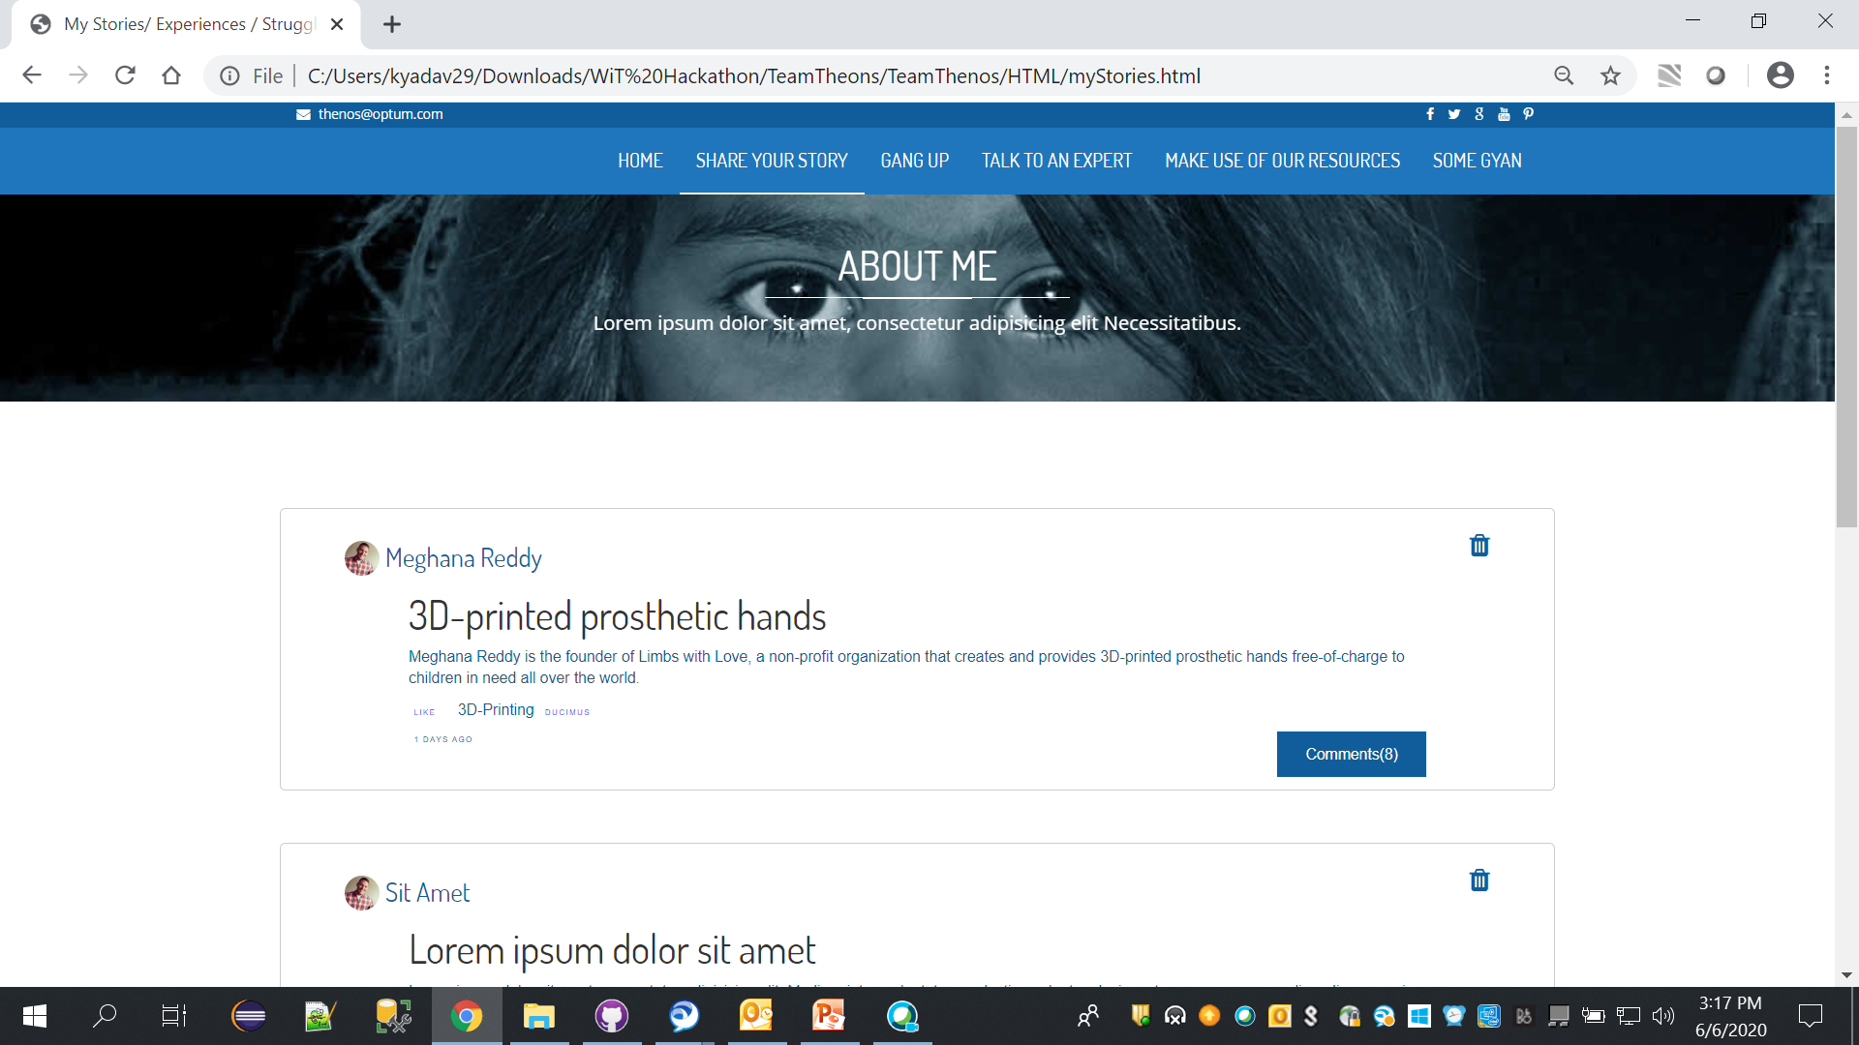
MY STORY
View All My Stories here
Remove story
View and comment here

Slide 9
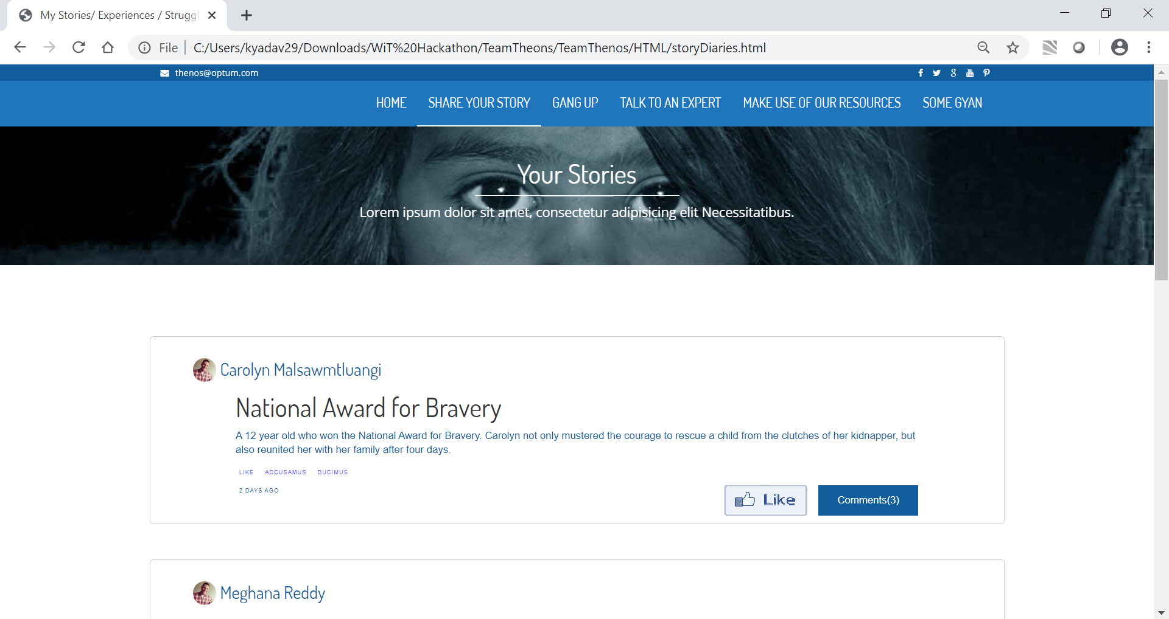
STORY DIARIES
View Every Story
& Comment
Like Them

Slide 10
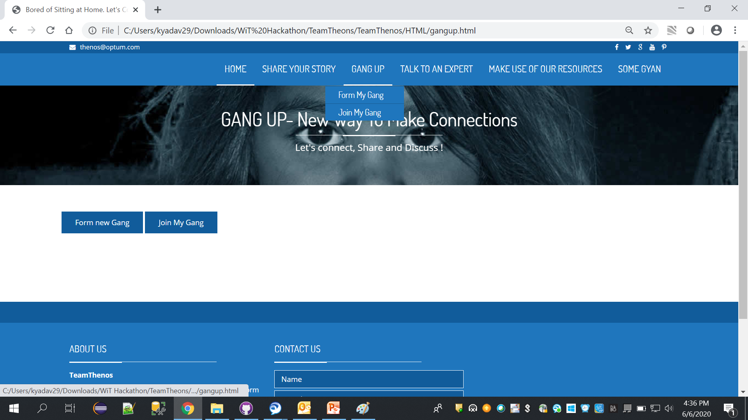
GANG UP
Come GangUp and learn,
Do some activities together
yoga,
craft,
cooking,
mask creating,
children engaging activities etc.

Slide 11
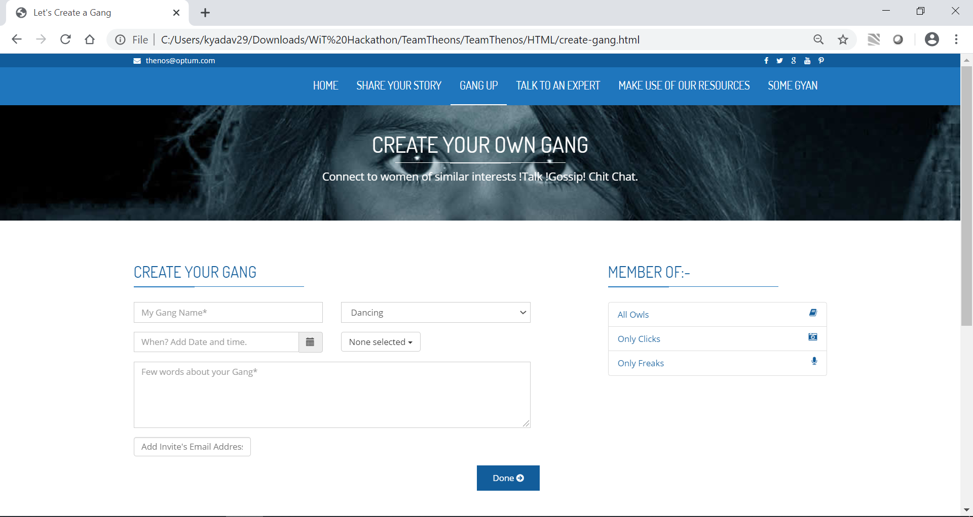
FORM MY GANG
Create a gang up meeting
Schedule it here
Select some rules
Describe it here
Email & Send it

Slide 12
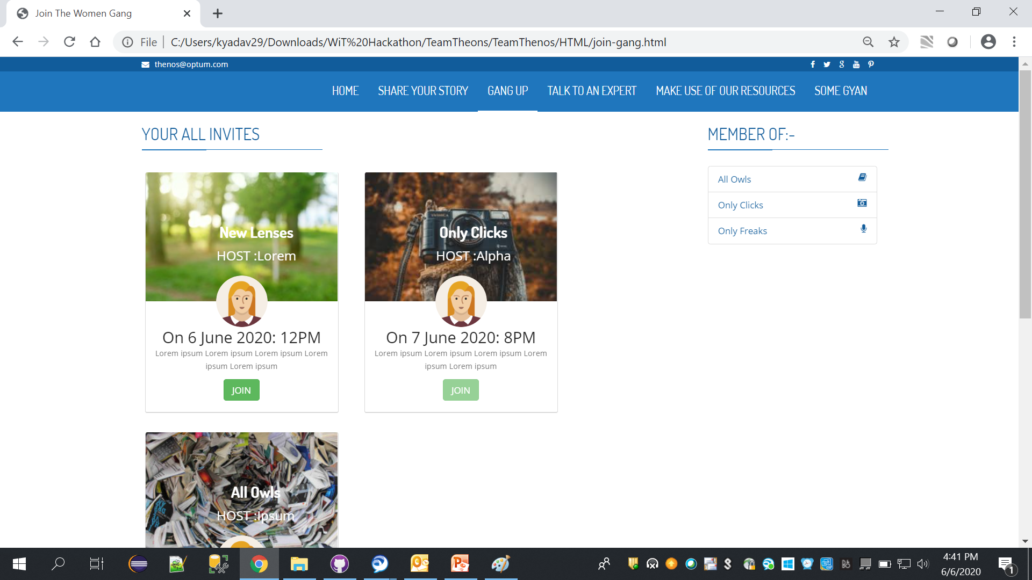
JOIN MY GANG
Join the scheduled gang up meetings here.

Slide 13
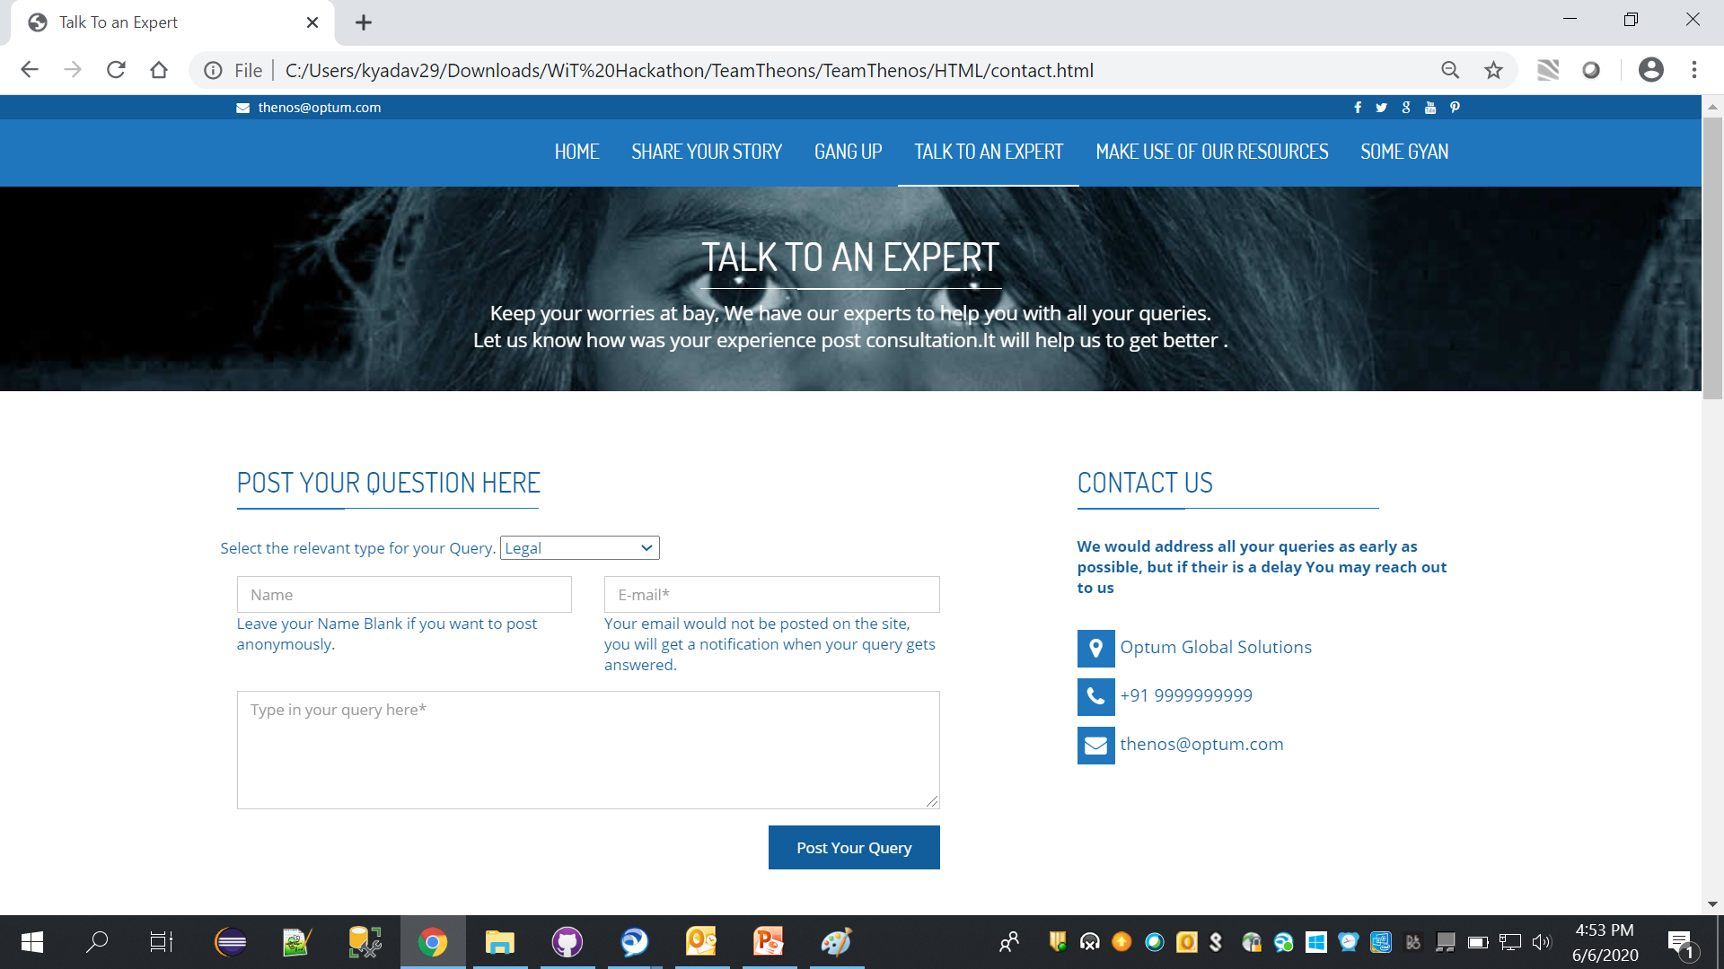
TALK TO AN EXPERT
Need some expert advice
Experts from respective fields answer your query here
Ask your question
Get reliable response

Slide 14
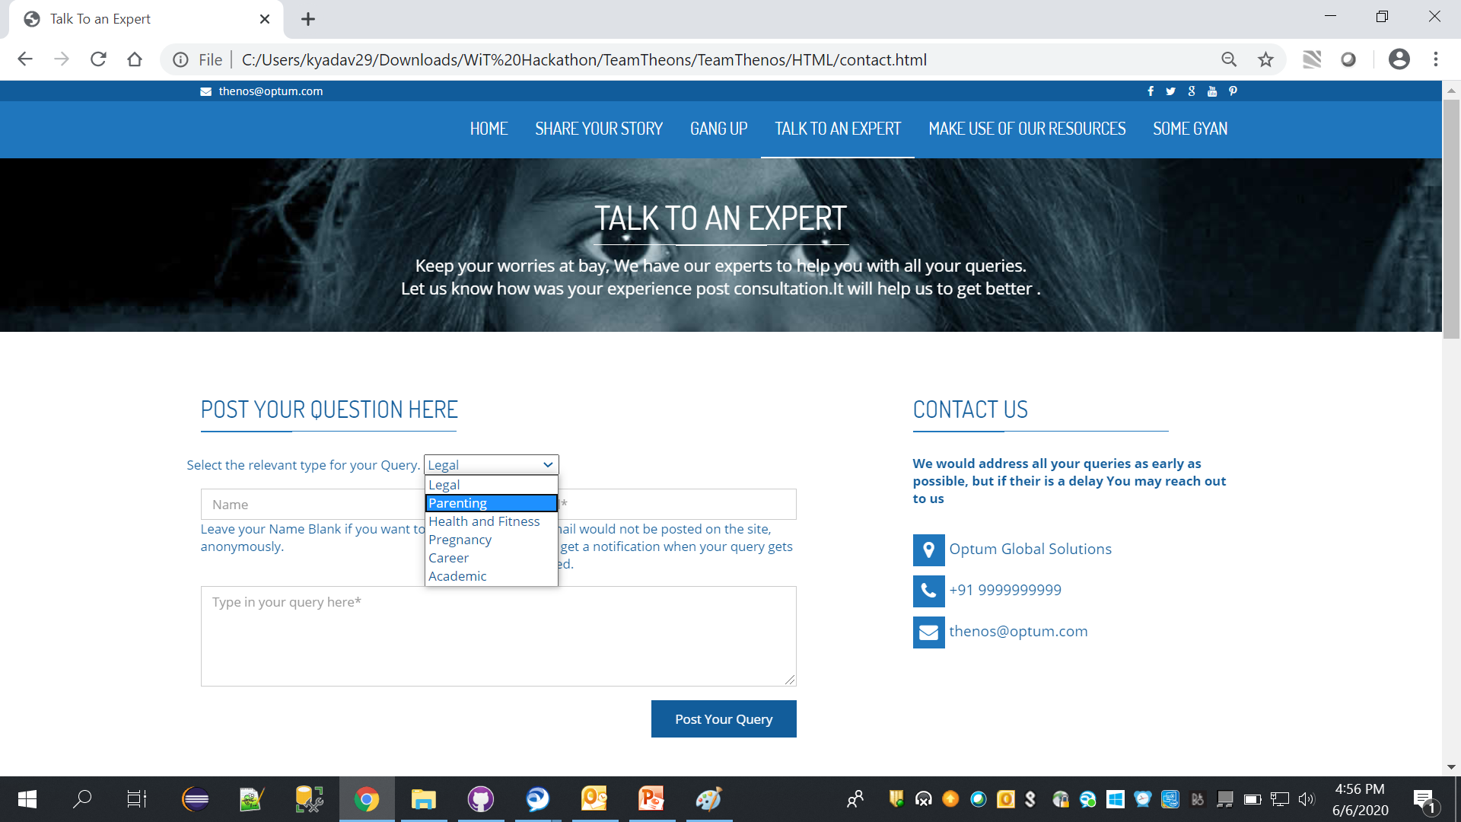
TALK TO AN EXPERT
Select category
Enter your query
& Post it

Slide 15
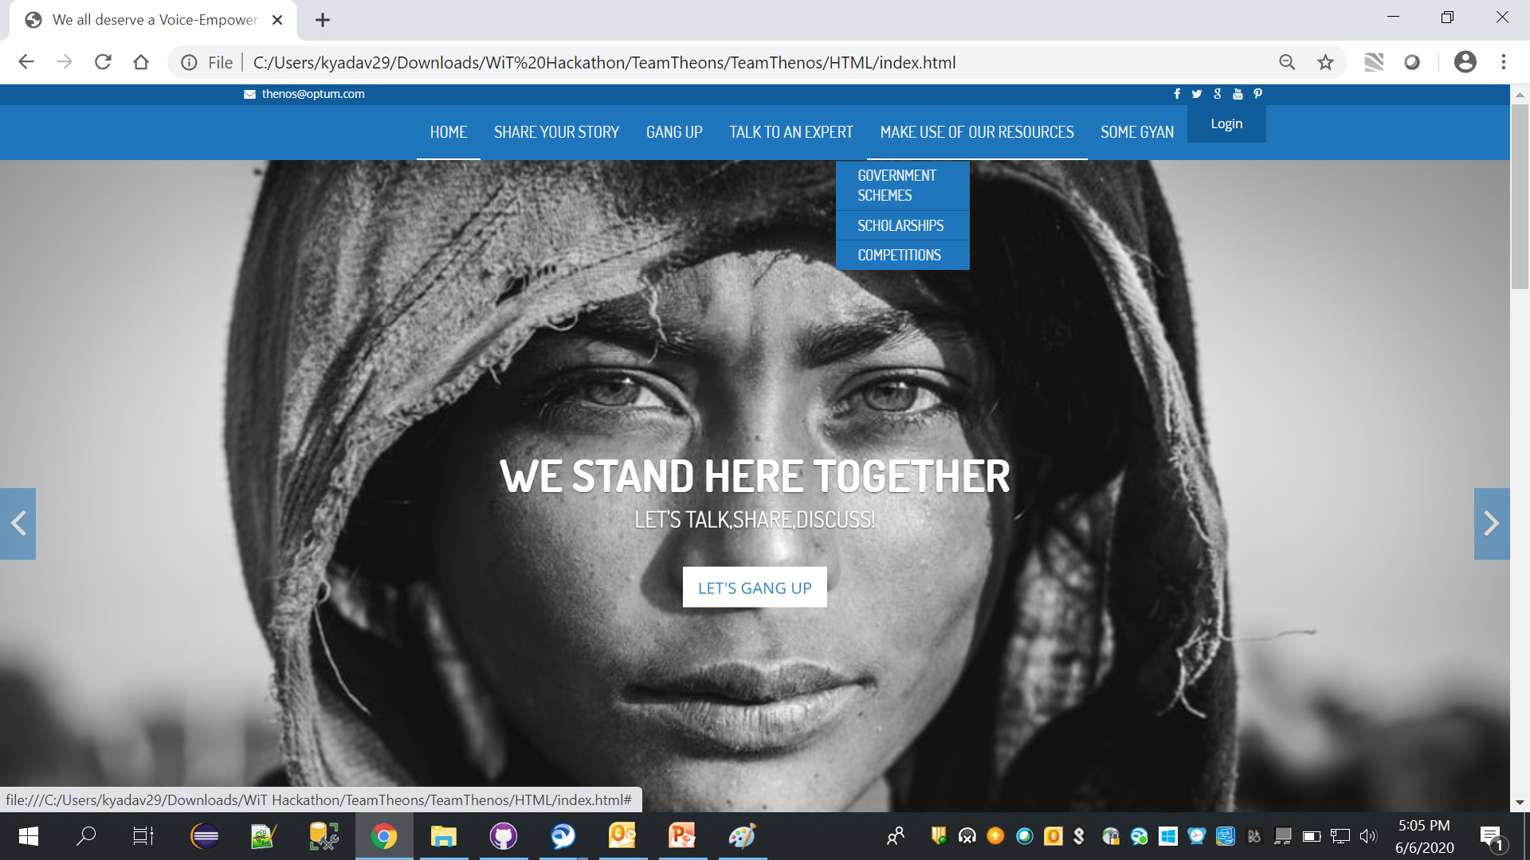
MAKE USE OF OUR RESOURCES
Walk with govt guidelines
Get your facts checks with govt.
Get all in one place

Slide 16
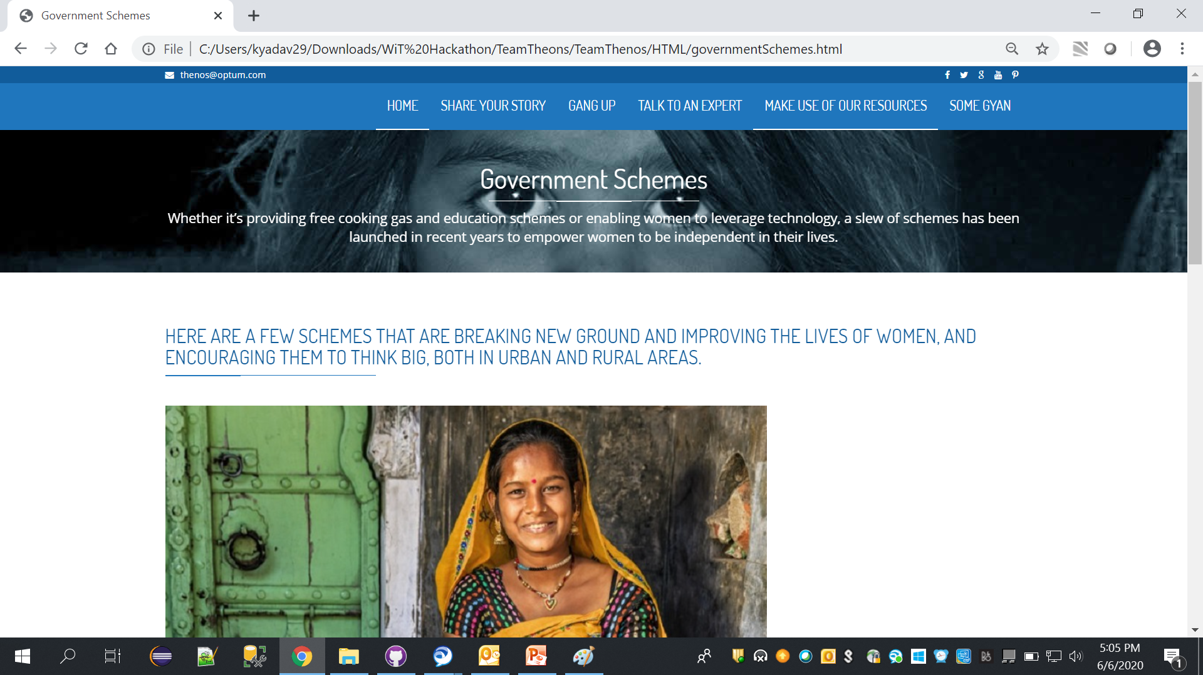
MAKE USE OF OUR RESOURCES

Slide 17
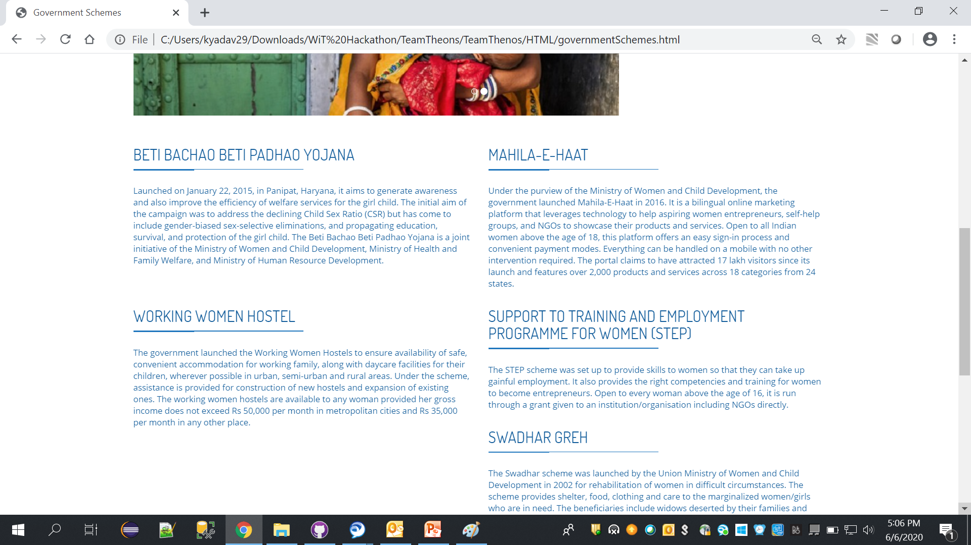
MAKE USE OF OUR RESOURCES

Slide 18
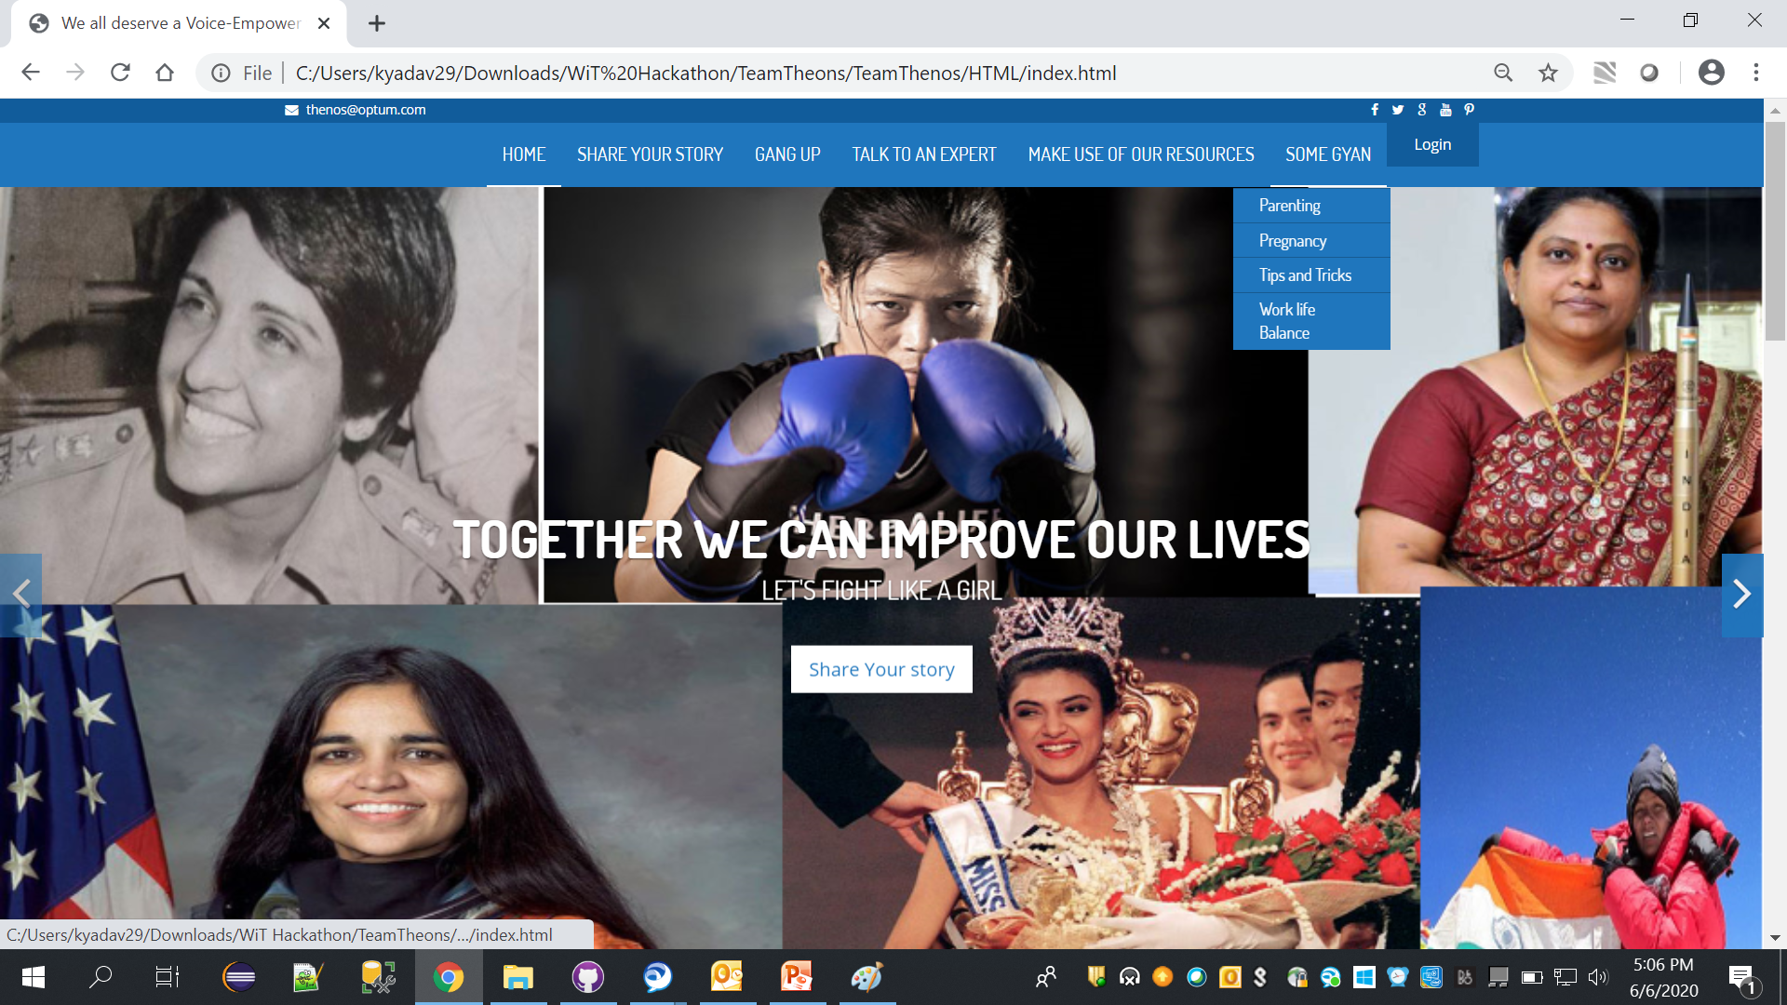
SOME GYAN
Get Some advice from experiences and experts

Slide 19
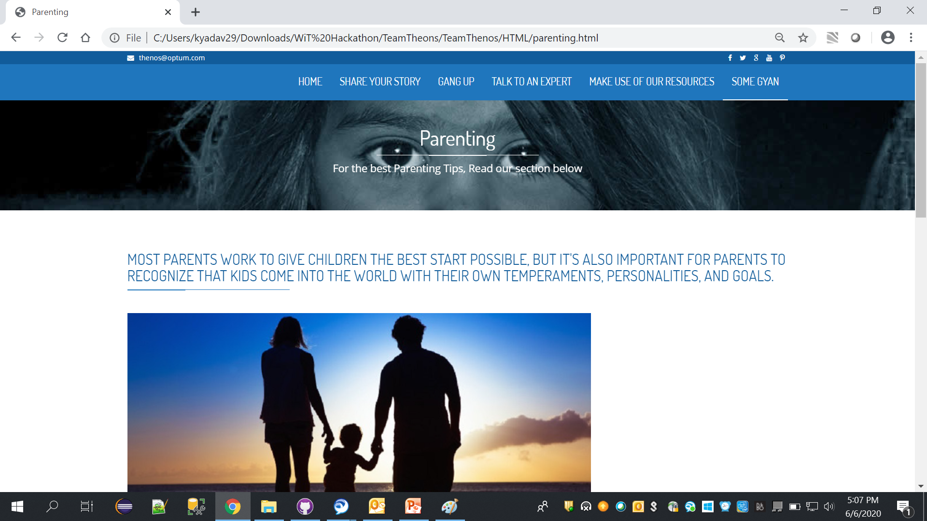
SOME GYAN

Slide 20
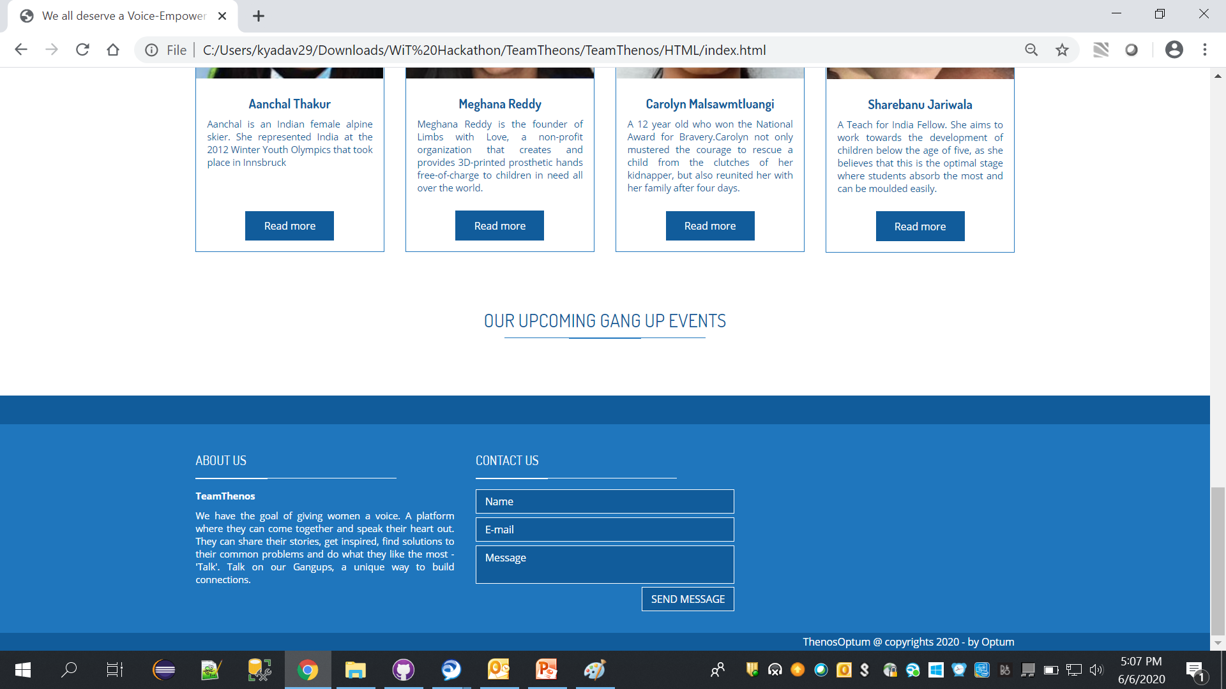
CONTACT US
For any query Contact Us

Slide 21
Thankyou

